Slide 1
KEY LEARNING from an Electrical Discharge [Dangerous Occurrence] that occurred on Thurs 03 October 2013

Slide 2
Incident summary
After completing works for the day and in heavy rainfall the operator of a Tracked Excavator (Excavator) owned and operated by a drainage sub-contractor to bmJV was travelling S/B within the central reserve work area, under temporary TM scheme.
It was travelling towards J40 on the M1 Motorway and then to a safe parking area. As the Excavator approached 11kVA overhead cables which spanned the works there was an electrical arc from the cables to the Top knuckle of the Excavator Boom, that was not in a safe stowed position
The Tracked Excavator continued a short distance to a safe area away from the overhead cables and stopped.
No injury was sustained by the operator of by any other personnel and there was no physical damage to the overhead cables, as confirmed by the cable owner
Location: M1 Motorway S/B Central Reserve work area, approaching M1/J40

Slide 3
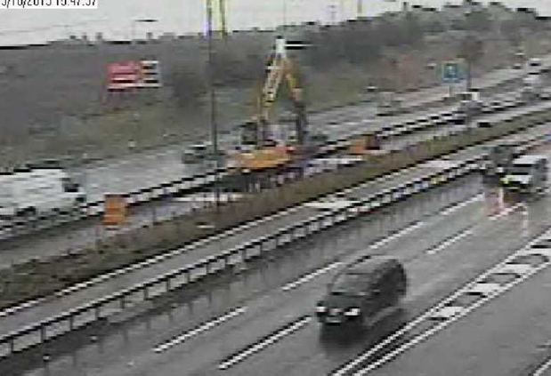
Photo (above) shows the Excavator travelling at the point immediately prior to the overhead cable discharge. Top knuckle of the Boom was estimated to be 6m above carriageway level.

Slide 4
Key learning

Slide 5
Key learning – Slide 1 of 5
Overhead cable clearance signs were improved to further clarify (1) safe working heights and (2) safe travelling heights
All actual cable heights were surveyed and put onto cross sections. This information was linked to M1 Motorway chainage markings, produced in tabular format (Excel File) for cross-referencing against existing temporary TM layout drawings
A review of GS6 Safe Clearance Assessment reports was undertaken with Northern Power (cable owners) to:
Check requirements for passage of vehicles beneath overhead cables, details for which had been carried out
Consider insulating overhead cables to reduce risks [this was not progressed]
Identify any opportunities to turn off electrical supply to remove safety risk during work periods [this was not progressed]

Slide 6
Key learning – Slide 2 of 5
Speed ramps were sited prior to each overhead cable location, on both north and southbound carriageways (within central reserve construction area).
This was repeated in verge work areas, and provided (provides) additional reminder to all plant operators and vehicle drivers that they are passing beneath overhead cables
A review of goal posts and warning protection in place at adjacent to all overhead cable and structure locations was undertaken, with controls measures corrected as required
A combination of goal posts, signage, road markings, blue coloured road cones (and speed ramps before O/H cables) were re-produced at each location

Slide 7
Key learning – Slide 3 of 5
High Voltage Detection Systems [HVDS] were trialled by the drainage sub-contractor. This was not progressed (following review), with physical controls implemented and monitored, post incident, deemed to be sufficient
A schedule of heights of works vehicles and mobile plant items was produced, to establish if specific Risk Assessments were required, as additional control during travelling beneath overhead cables or structure. This information was provided by PC, sub-contractors and suppliers, and remains a fluid action
To this end, a maximum travelling height across all work areas of 4.9m was established, with signage erected (and maintained) at all locations
A “permit to travel” form was also introduced for use by large sized mobile plant items
Height restrictors were fitted to Excavators in preparation for planned works beneath and adjacent to overhead cables.
Safe systems of work documentation (Activity plans) include a “Named person” for responsibility to set and lock restrictors in place

Slide 8
Key learning – Slide 4 of 5
Laser alarm systems (Intellicone), initially trialled in the project compound, have been used successfully, as an additional control for vehicular traffic, including member of public vehicles, travelling beneath motorway under-bridges, whilst improvement and modification works have been undertaken
All operations to be checked for appropriate consideration and management of the risks associated with overhead cables – including but not restricted to;
Installation and removal of temporary vehicle restraint systems (i.e. Varioguard barrier)
Use of IPV’s, loading and unloading of equipment and materials, travelling of mobile plant equipment fitted with GPS equipment (i.e. aerials)
Mobile plant equipment that have the ability to travel with part of their body in a raised position, i.e. not safely stowed, such as booms, hydraulic arms or tipper vehicle bodies

Slide 9
Key learning – Slide 5 of 5
Overhead structure clearance signs are to be improved to further clarify safe working heights
Systems to improve communication between operator of mobile plant item / vehicle and Vehicle Banksman have been explored, including;
Use of hearing protection from Peltor Protection systems, that allows verbal communication between plant equipment operator and Banksman, without a loss of the sense of hearing to other activities in and around the immediate work area
Monitor and review of effectiveness of items referred to above, key elements from which were in an update of Raising the bar 7, Overhead structure and services protection, issued in May 2015

Slide 10
Photo montage

Slide 11
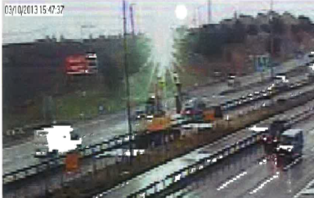
Excavator at point (time) of electrical discharge

Slide 12
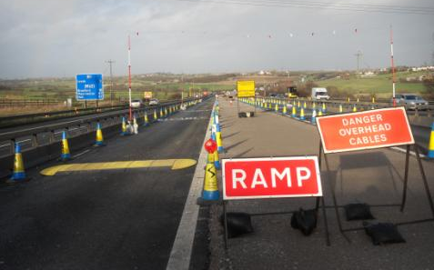
Protection in place ahead of each overhead cable locations
Notes:
12
Discuss cable incident – possible show DVD

Slide 13
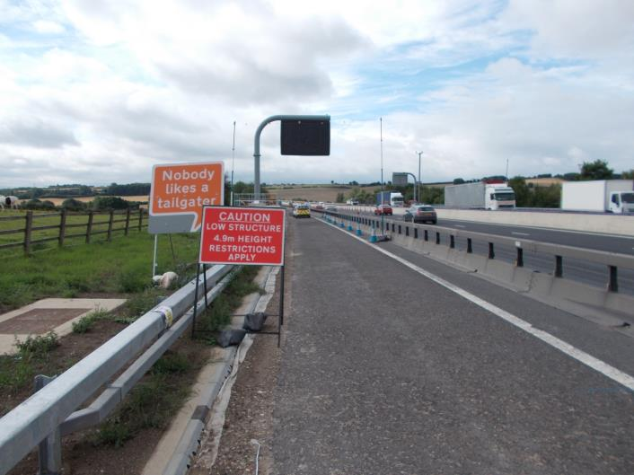
Travelling height restriction (4.9m) sign – used site wide
Notes:
13
Discuss cable incident – possible show DVD

Slide 14
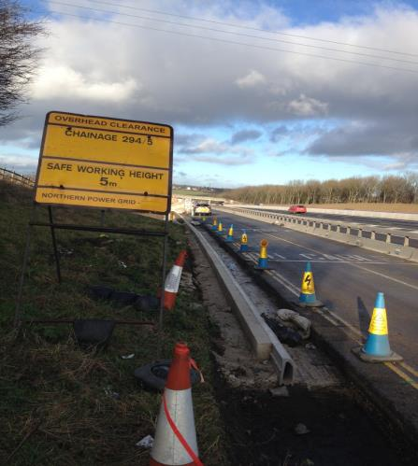
Typical overhead services information sign

Slide 15
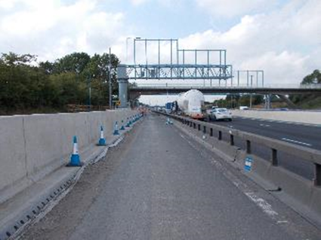
Overhead structures – example protection in 2015, signage out of photo shot

Slide 16
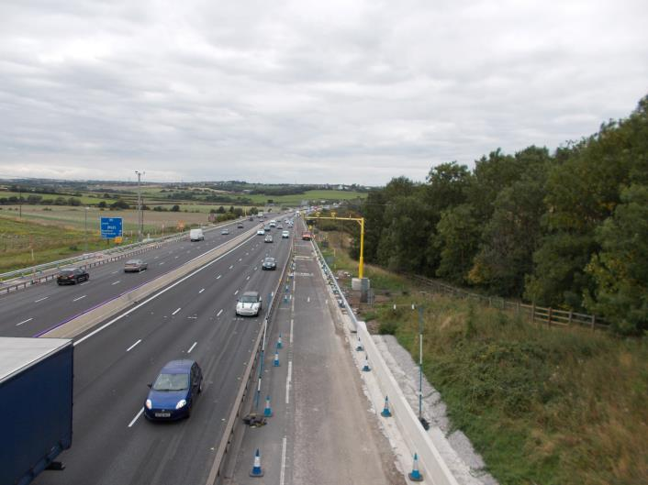
Overhead structures – example protection in 2015

Slide 17
Slide extract from site safety induction PPT

